Slide 1
Samad, Guandong, and Tyler
Brain Stimulator Progress Update

Slide 2
Problem Description
Make a device that can generate waveforms of precise frequency and current to stimulate deep parts of the brain using electrodes.

Slide 3
Key Events from Last Week
Bluetooth connectivity with rpi
App layout/research
Programmable gain amplifier research
Continued battery search

Slide 4
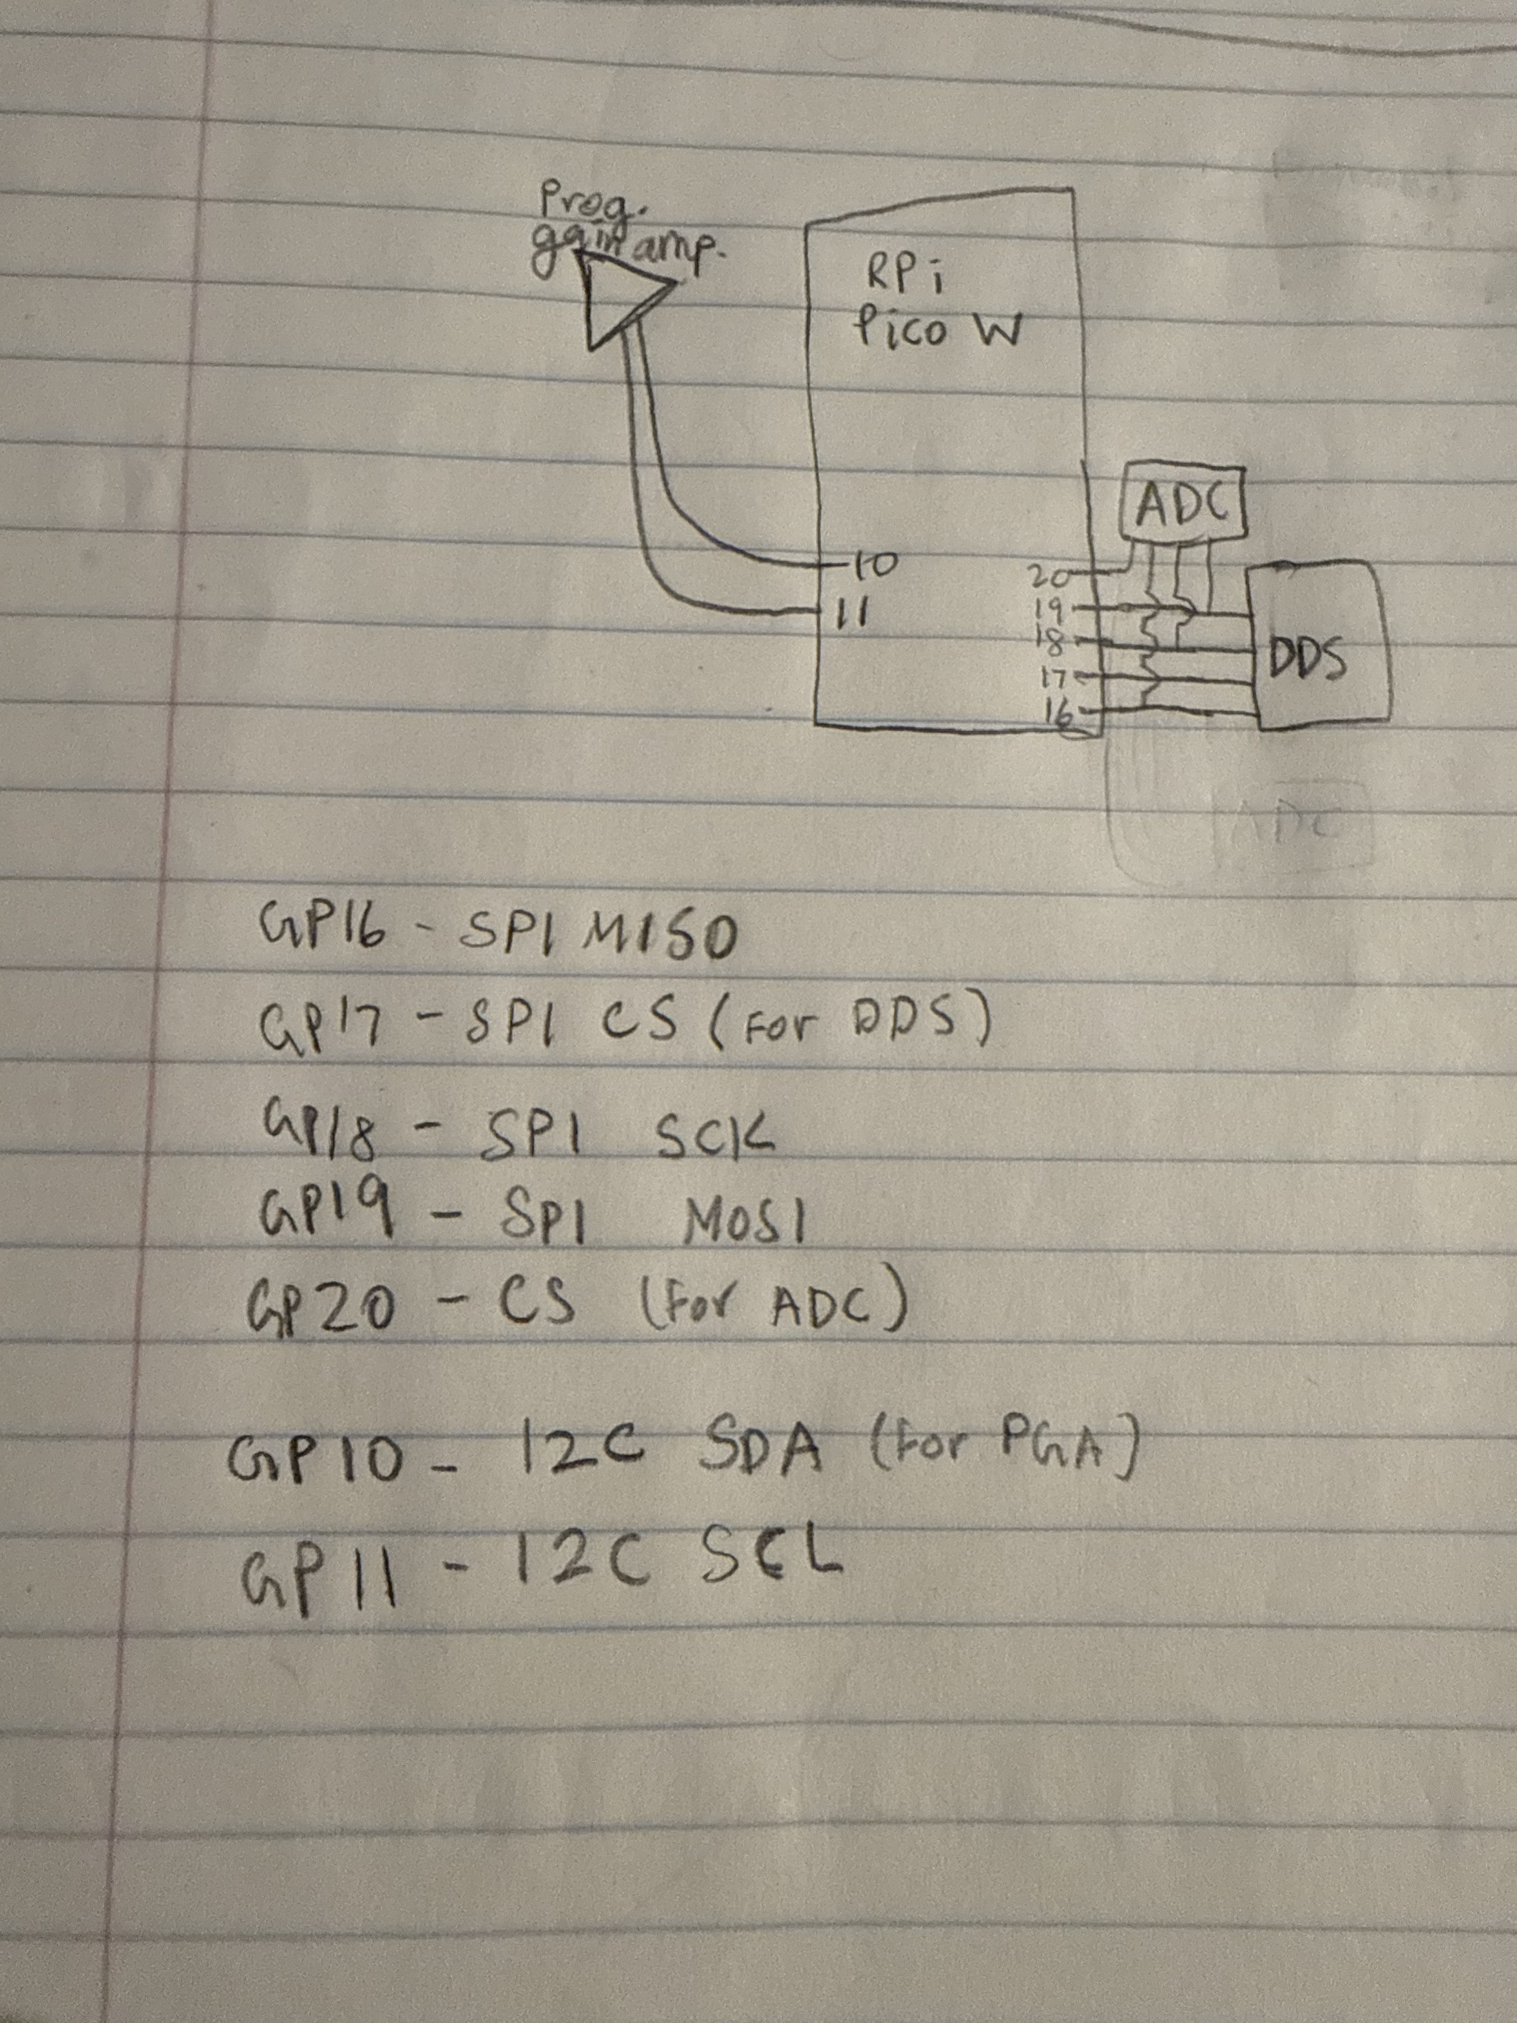
MCU Pinout
Don’t need many operations outside of communicating with peripherals.

Slide 5
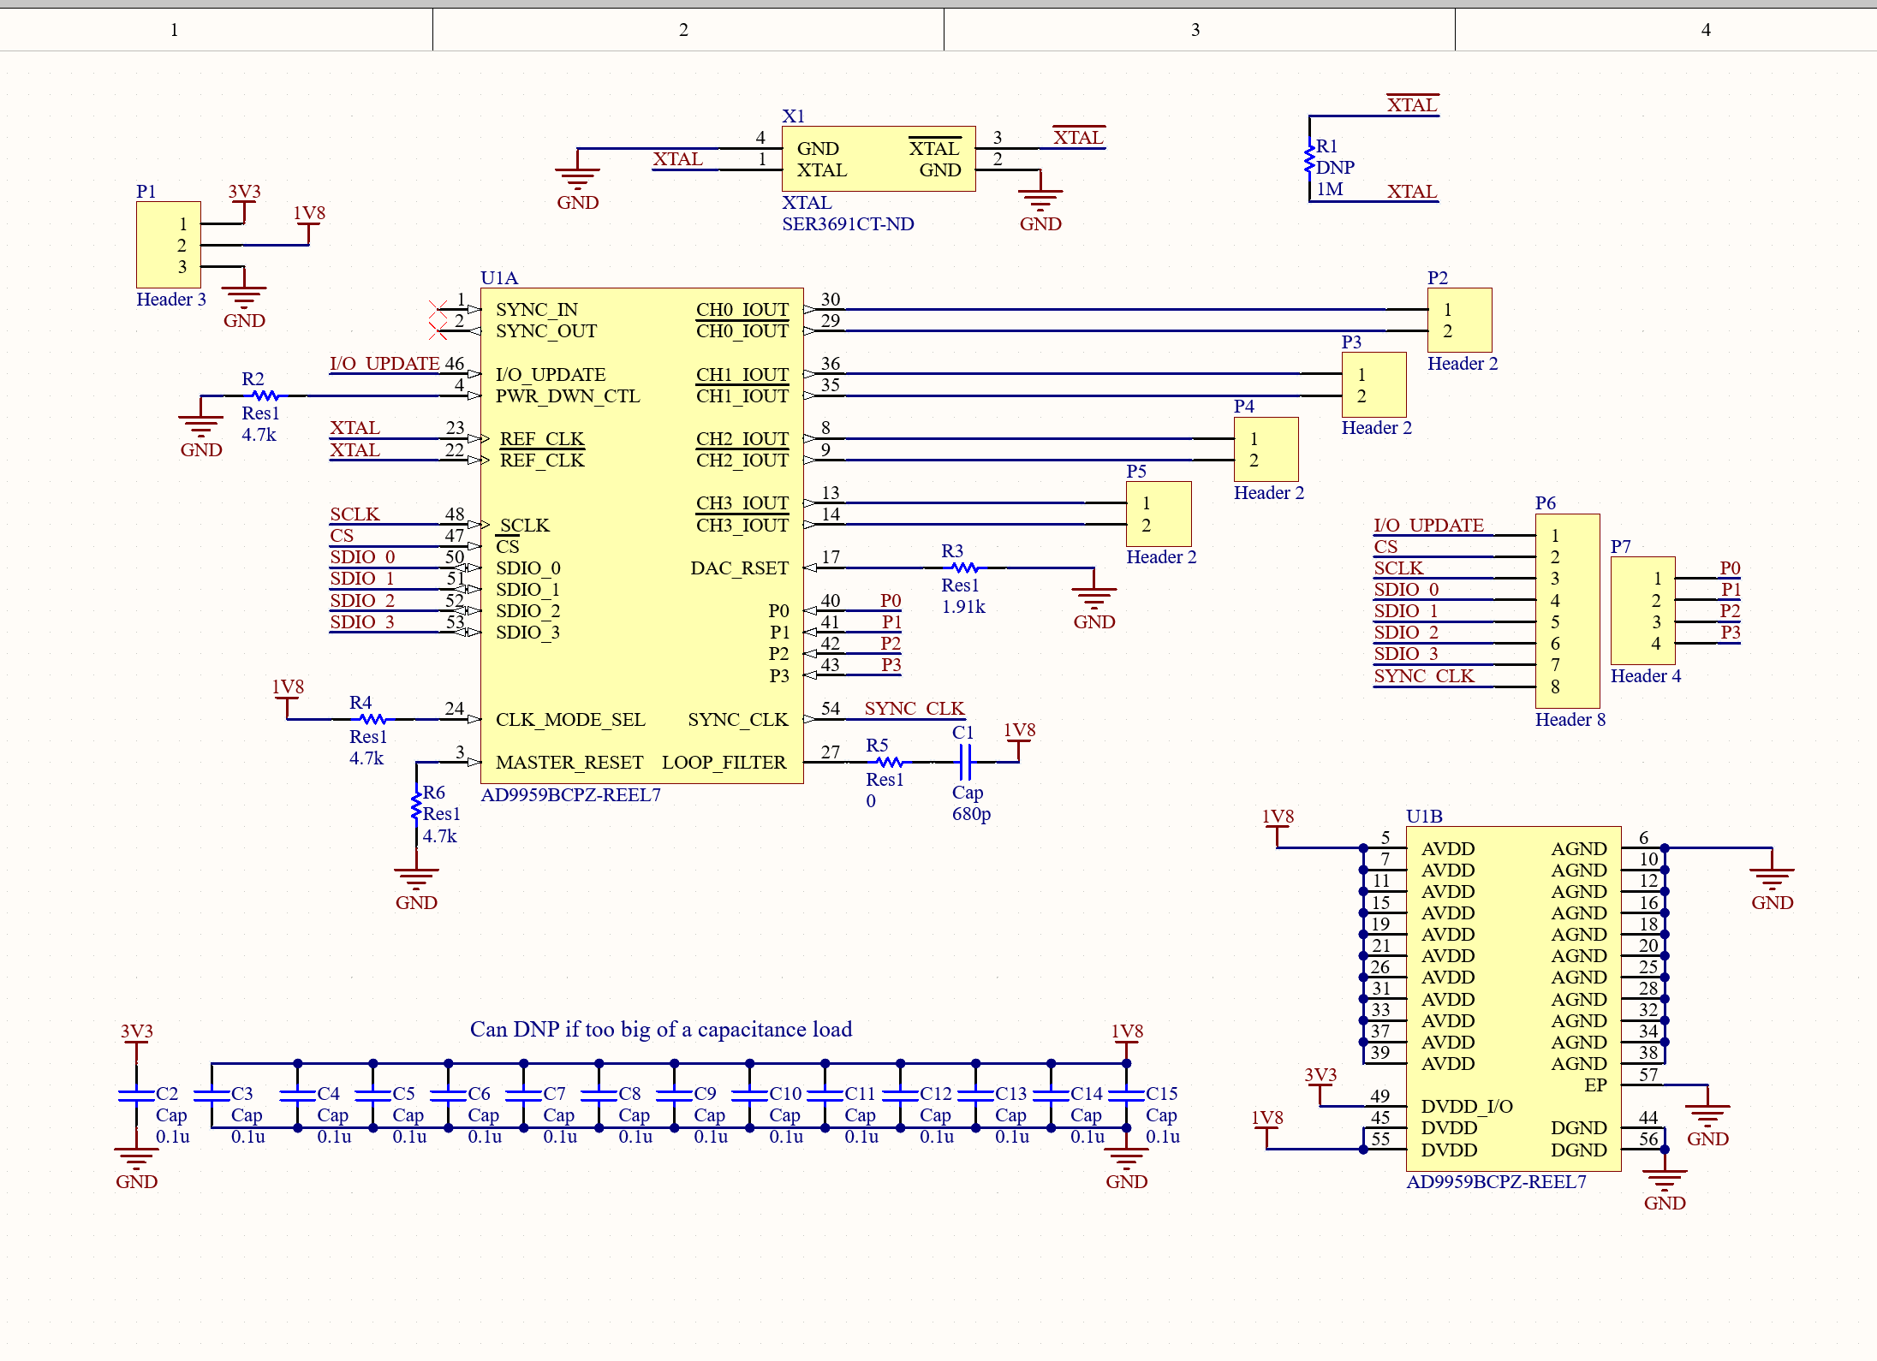
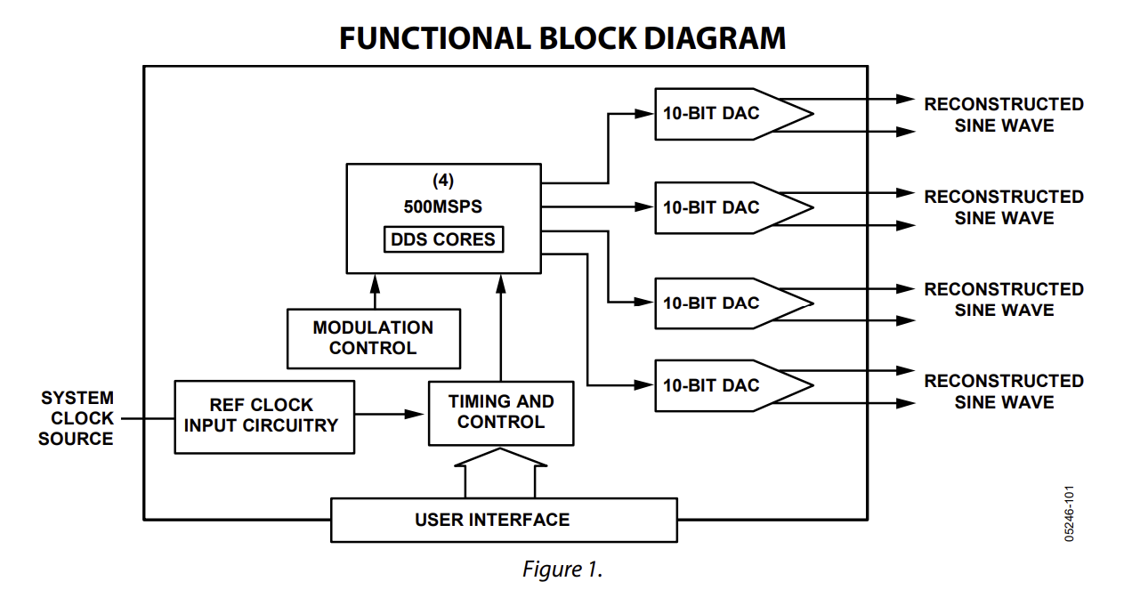
DDS Module

Slide 6
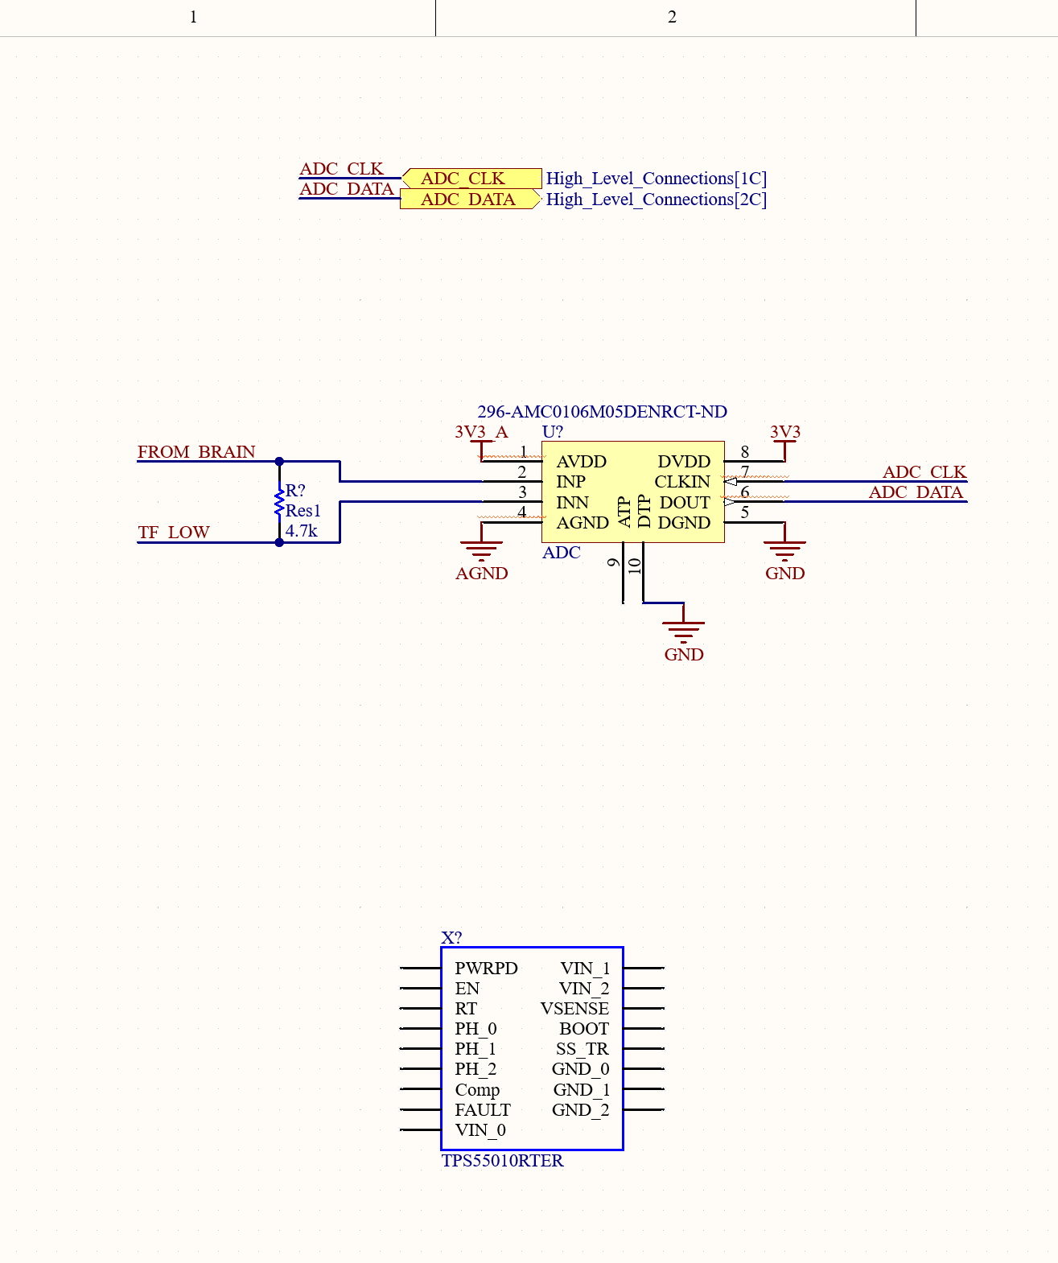
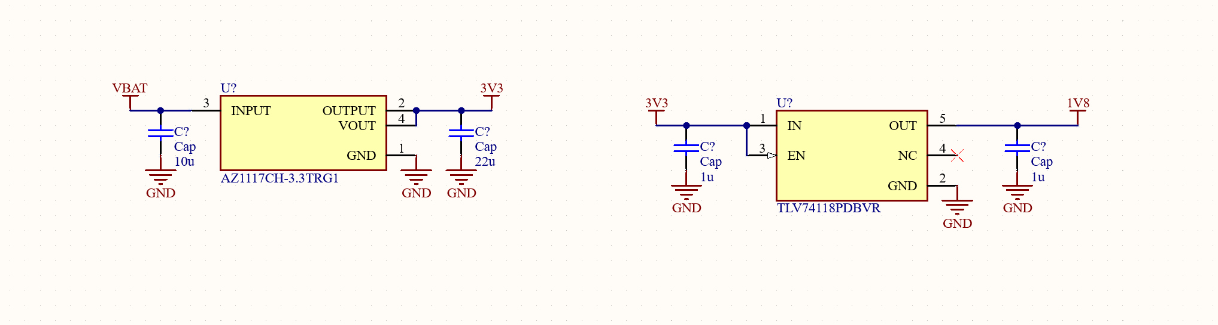
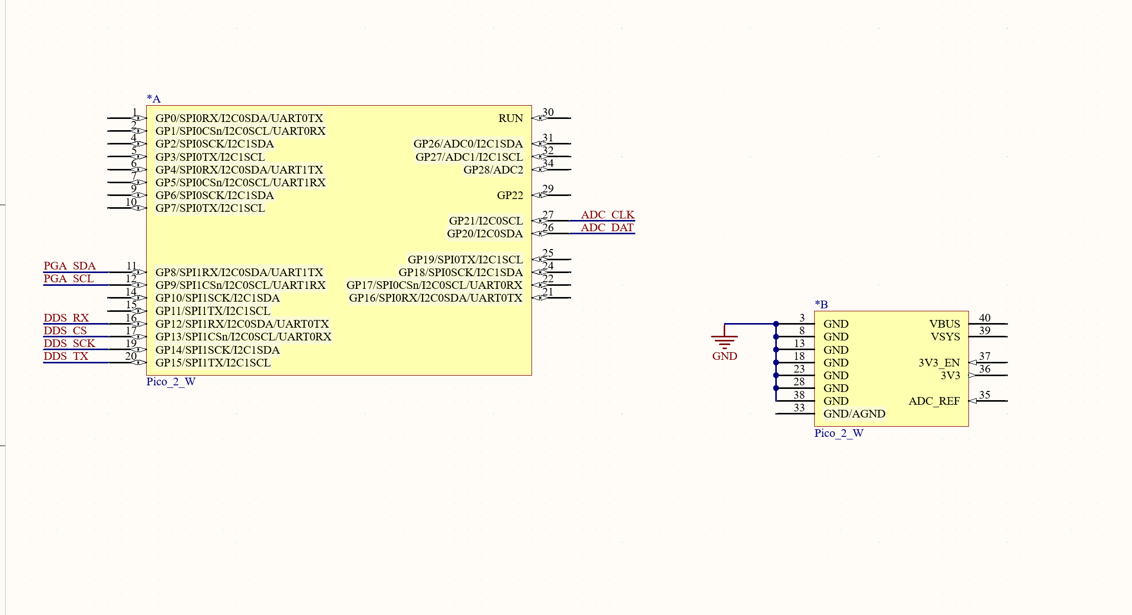
Schematic Updates

Slide 7
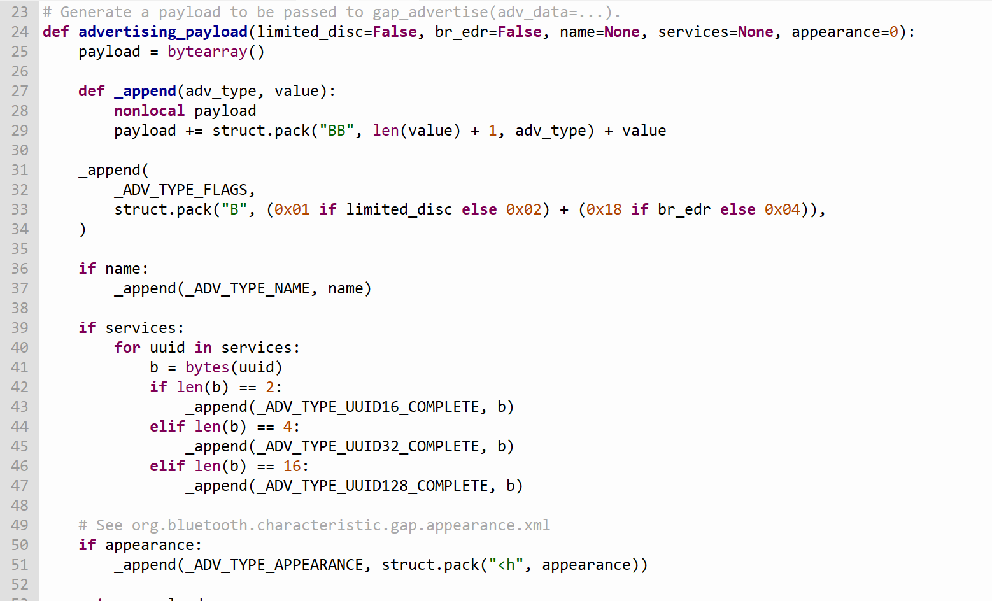
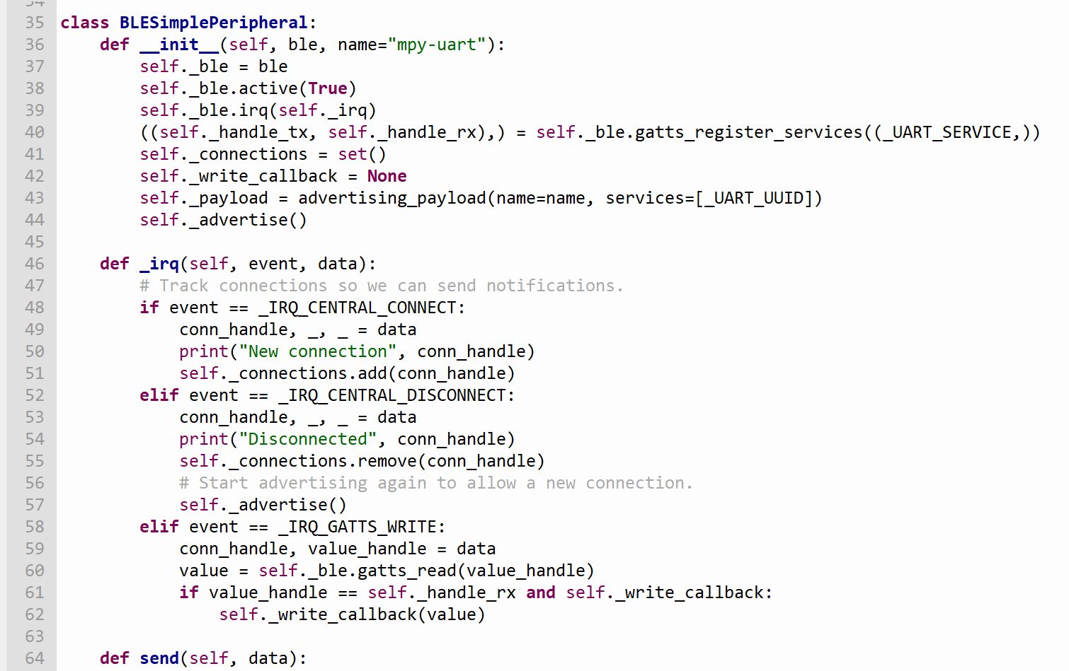
Bluetooth Connection to the MCU (Raspberry pi Pico W)
Save two MicroPython modules in our RPi Pico to communicate via Bluetooth Low Energy
Helpers for generating BLE advertising payloads
Creates a simple BLE peripheral
https://electrocredible.com/raspberry-pi-pico-w-bluetooth-ble-micropython/

Slide 8
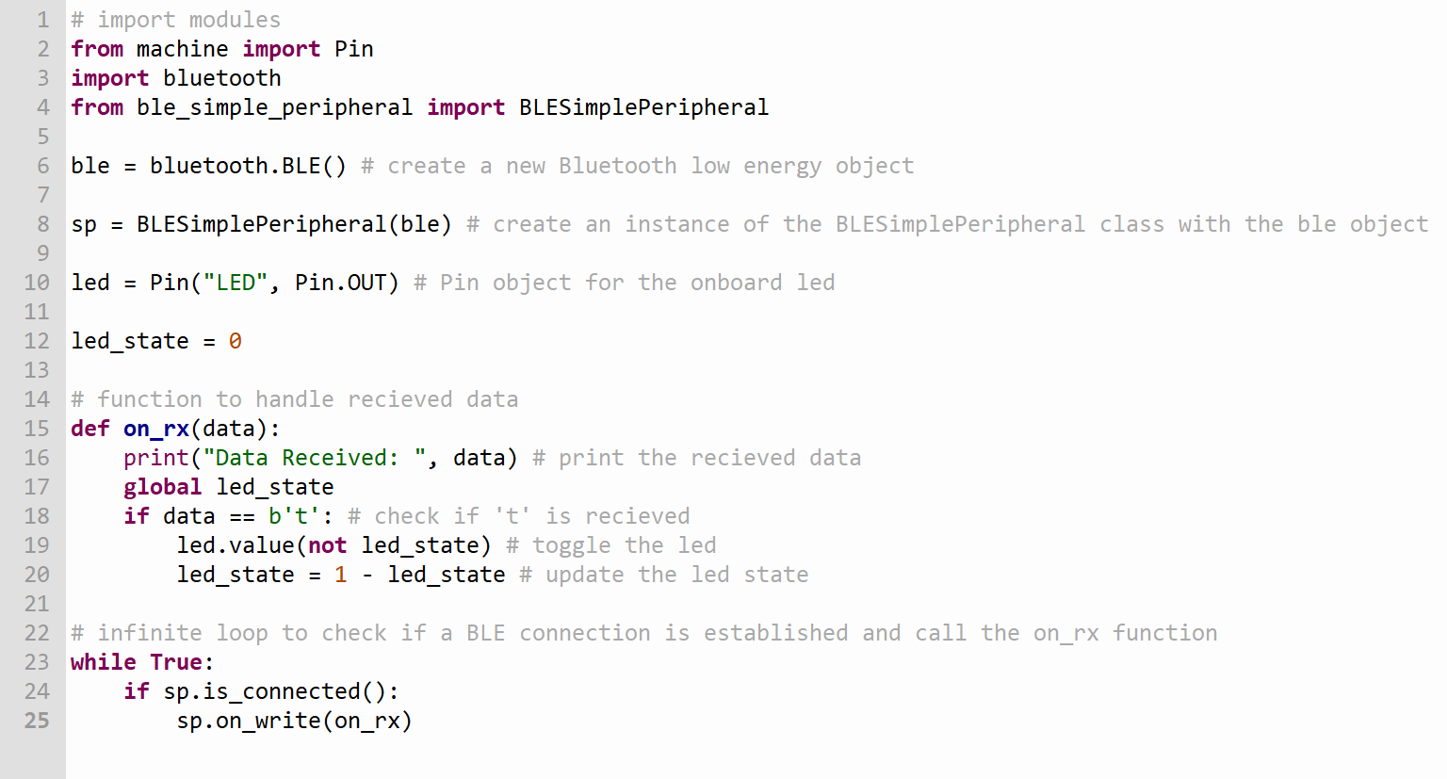
Bluetooth Connection to the MCU (Raspberry pI Pico W)
Code to control the onboard led with a Bluetooth terminal on phone

Slide 9
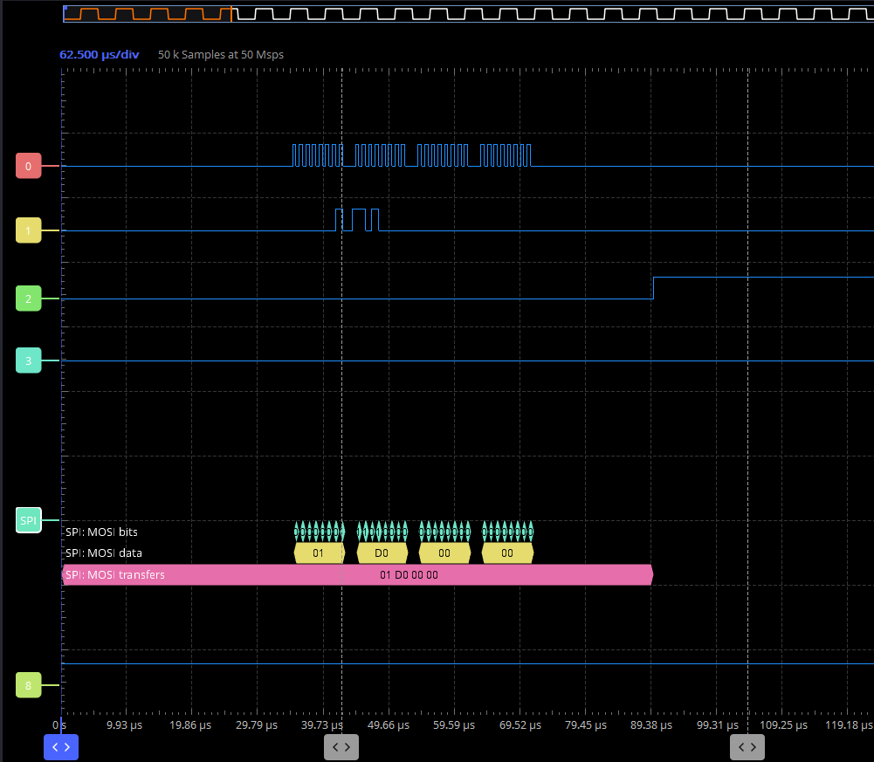
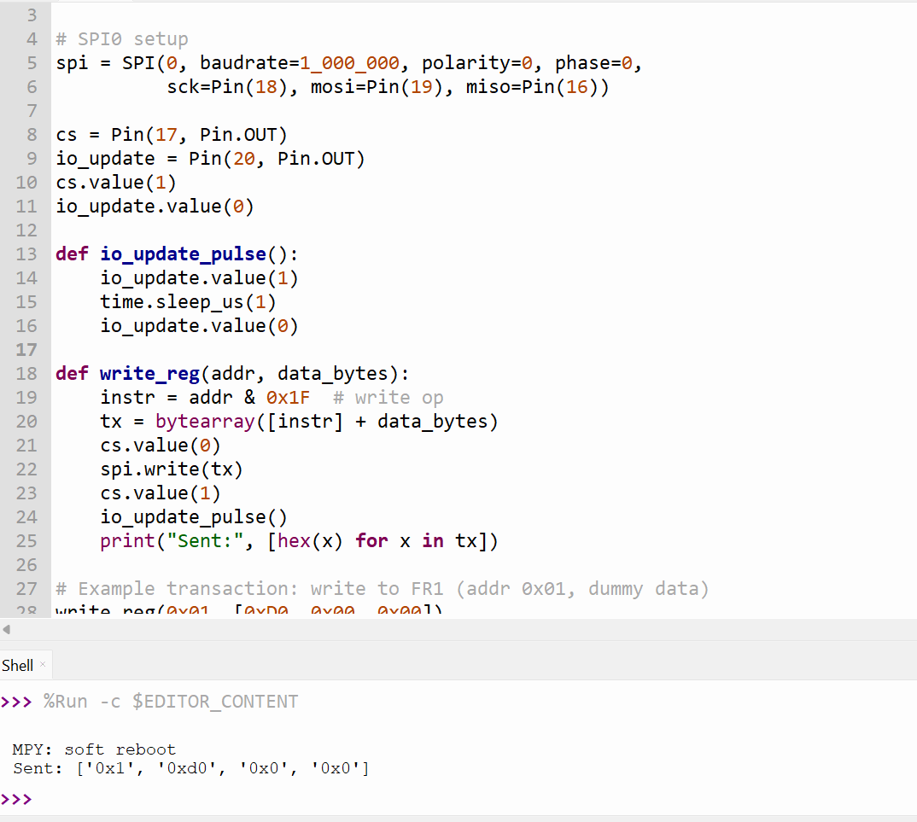
SPI Testing with The Raspberry PI
This simulates writing to a function register in the DDS
Waveform caught by oscilloscope
Next, we need to test it with DDS directly

Slide 10
Web App
Choosing browser based for best portability
Using webbluetooth with JS
Need room to expand easily to more channels

Slide 11
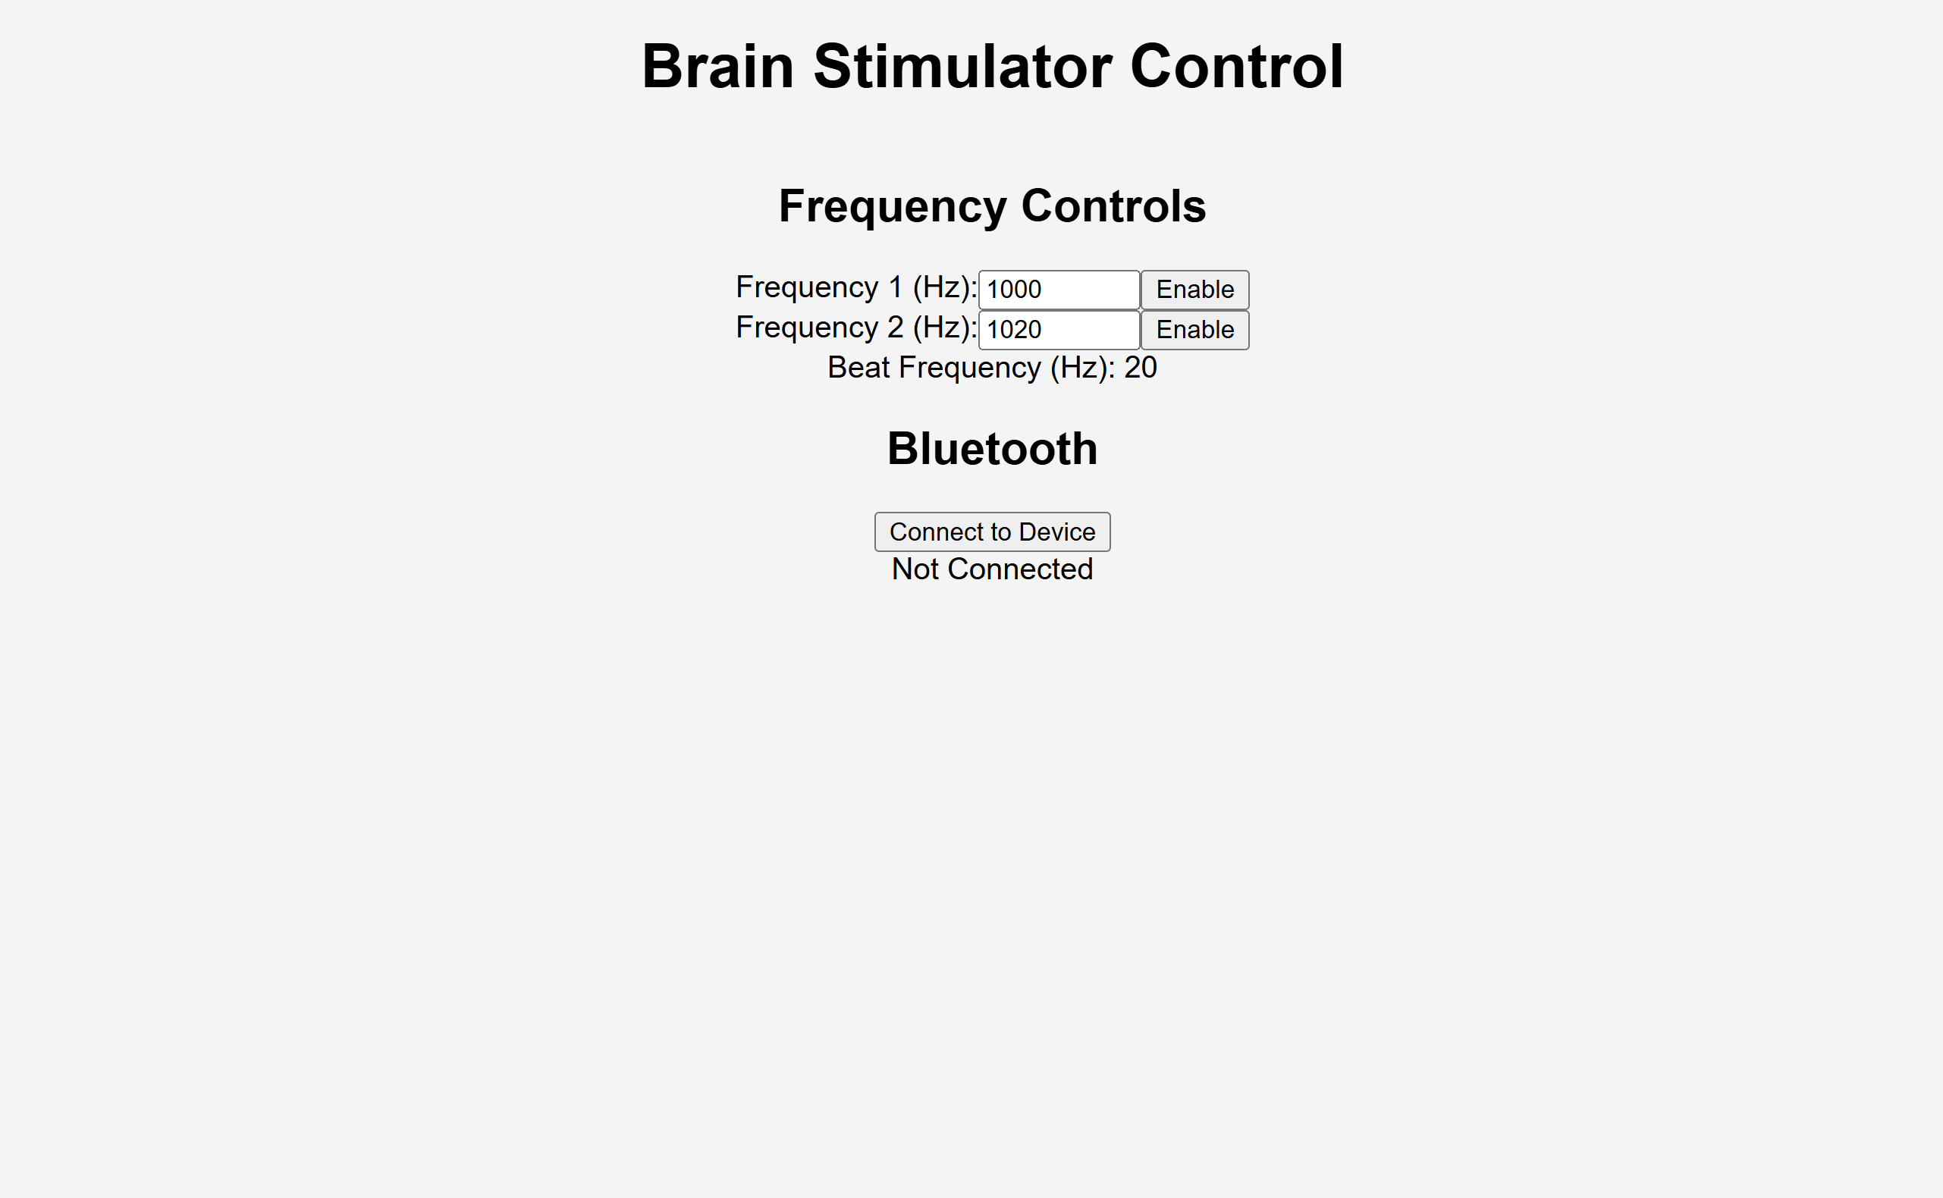
Web App Continued
(this is without CSS to make things pretty)

Slide 12
Plans for Battery
Calculate required amp hours to narrow search
Find something with integrated BMS
Use dimensions to make housing and board dimensions

Slide 13
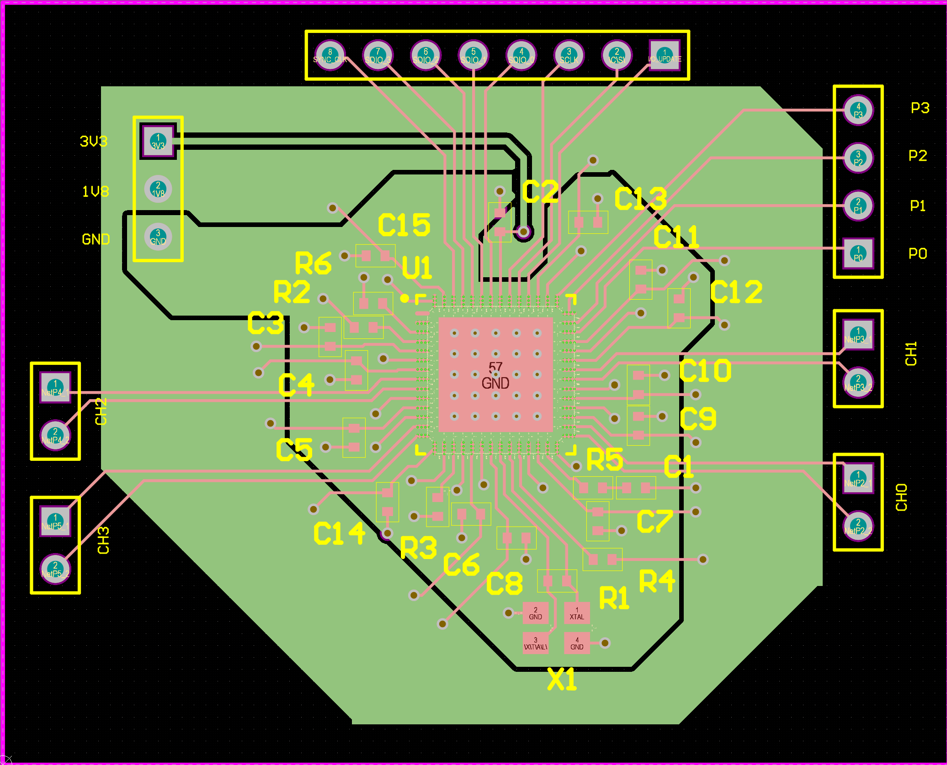
DDS Test Board
For SPI and programming

Slide 14
Challenges so far
Height limit with isolation transformers
Amplifier sourcing/creation

Slide 15
Immediate Plan
Continue schematic and symbol creation
Find battery for device
Determine board measurements for housing
Code pairing and app integration
DDS Verification

Slide 16
Questions/Feedback

